Slide 1

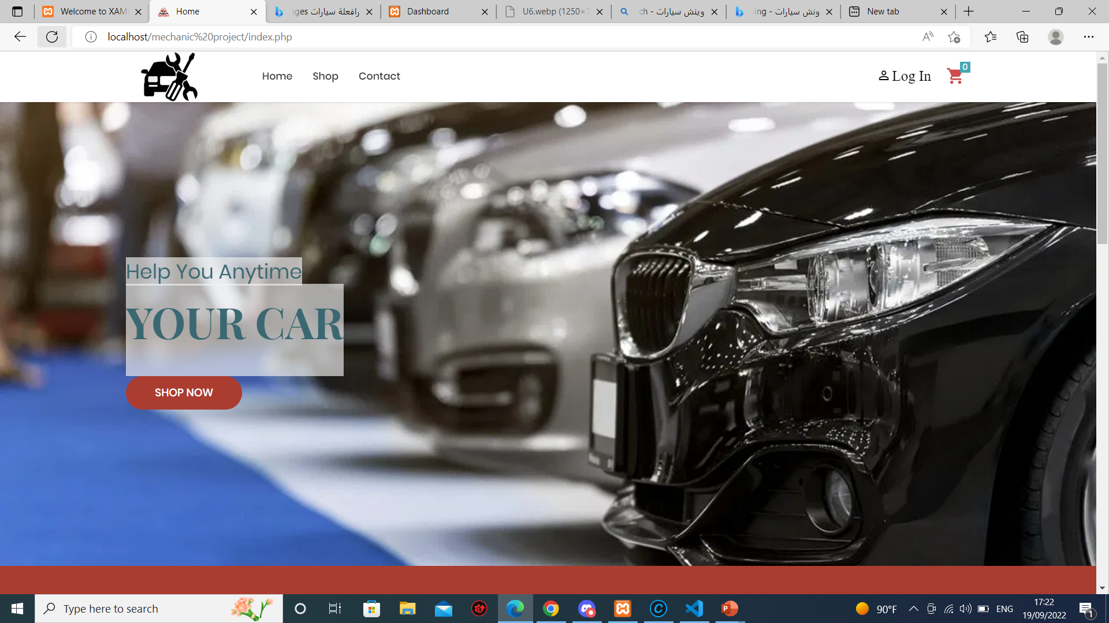
Help

Slide 2
TABLE OF CONTENTS
01
02
03
04
About website
Mission & Vision
Services
Recommendations

Slide 3
About
In this project, we will provide the user with the purchase of cars. Also, in the event of a car breakdown, the user can reserve a vehicle to carry cars, and if the cause of the malfunction is running out of fuel, he can buy fuel through the website

Slide 4
Mission & Vision
Mission
Due to what we see nowadays when we are outside, we need such a site because it provides 3 interconnected services, which saves the user time and effort.
Vision
In the near future, services that provide and communicate with mechanics will be added to maintain the car at the time of the user's need and anywhere, and the shipping service for electric cars will be provided.

Slide 5
Services
Bay Car
Book winch
Bay gas

Slide 6
Recommendations
Key partner
Car bayer , pepole who need help for thire cars
Channals
Revenue
website , Social media , gas copmany, large viechal
Bay car or book winch also, bay gas

Slide 7
03
LIVE DEMO

